Slide 1
HUMAN_SOS_ALERT
Presented By:
Presented To:
01 Md Mehedi HassanStudent ID: 41230301594
SHEIKH TASFIA
Lecturer
Department of CSE
Northern University Bangladesh
02 Sk. Tanjid Ahmmed AponStudent ID: 41230301950
03 Ahnaf MottakeStudent ID: 41230201588

Slide 2
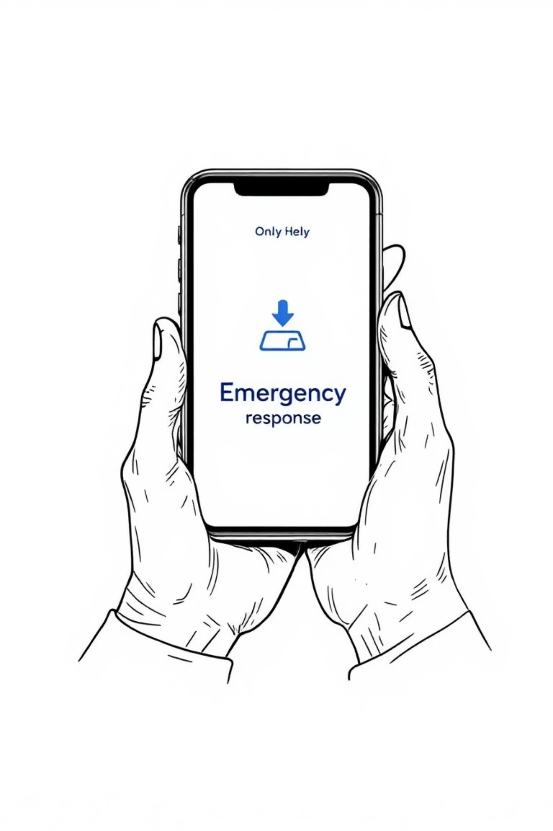
Human SOS Alert
Smart Emergency Response System

Slide 3

What is Human SOS Alert?
A revolutionary emergency response system designed to bridge the critical gap between crisis and help. When seconds matter most, our smart technology ensures help is just one touch away.
Built for real people facing real emergencies - from medical crises to natural disasters, accidents to personal safety threats. This isn't just an app; it's a lifeline.

Slide 4

The Critical Problem We Face
Rising Emergency Incidents
Communication Delays
Accidents, natural disasters, and crimes are increasing globally, with response times often determining outcomes between life and death.
Traditional emergency systems can be slow, unreliable, or unavailable when people need them most - especially in remote areas.
Location Uncertainty
Emergency responders often struggle to locate victims quickly, wasting precious time that could save lives in critical situations.

Slide 5
Our Mission & Objectives
01
02
03
Instant Alert Delivery
Real-Time Location Sharing
User-Friendly Design
Send immediate notifications to emergency services and trusted contacts with a single button press, eliminating response delays.
Provide precise GPS coordinates to responders and contacts, ensuring help arrives at exactly the right place.
Create an intuitive interface that anyone can use during high-stress situations, regardless of age or technical skill.

Slide 6





Core System Features
Emergency SOS Button
GPS Tracking
Multi-Role Access
Multi-Channel Alerts
Precise location data shared instantly with responders (For future upgradable)
Separate interfaces for users and emergency coordinators
Simultaneous notifications to multiple emergency contacts
One-touch activation that works even when the screen is locked

Slide 7



Technology Stack & Infrastructure
Frontend Interface
Backend Architecture
Communication Hub
Cross-platform mobile application with responsive web interface, ensuring accessibility across all devices and operating systems for universal emergency access.
Robust Node.js server infrastructure with MySQL database, designed for high availability and rapid response times during peak emergency situations.
Multi-channel notification system utilizing SMS, email, and push notifications to ensure alerts reach recipients through redundant communication pathways.

Slide 8



Our System Architecture
Frontend Interface
Backend Logic
Data Management
Developed with standard web technologies, the frontend ensures intuitive user interaction for sending and receiving alerts.
The robust backend processes all alert requests, manages user data, and ensures reliable communication pathways.
A secure and scalable database solution is in place to store all critical information, from user profiles to alert histories.
Node.js for server-side operations
MySQL for relational data storage
HTML for structure
CSS for styling
Express.js framework for API handling
Optimized for rapid queries
Js
Ensures data integrity and security
Efficient request processing

Slide 9





How It Works: System Flow
User Activation
Emergency SOS button pressed during crisis situation
Location Detection
System instantly captures precise GPS coordinates
and user data
Alert Dispatch
Simultaneous notifications sent to emergency services and contacts
Response Coordination
Help dispatched with exact location and
user information

Slide 10



Life-Saving Advantages
Faster Response Times
Reduces emergency response time by up to 70% compared
to traditional methods
Lives Saved
Every minute matters in emergencies - rapid alerts can mean the difference between life and death
Universal Accessibility
Versatile Applications
Simple interface works for all ages and technical abilities, ensuring no one is left behind during emergencies.
Effective across multiple emergency scenarios: medical crises, accidents, natural disasters, and personal safety threats.

Slide 11

Overcoming Critical Challenges
Connectivity Issues
1
Challenge: Network outages during disasters. Solution: Offline alert capability with SMS backup and satellite communication options.
2
False Alarm Prevention
Challenge: Accidental activations. Solution: Smart confirmation system with 10-second cancellation window and pattern-based activation.
Privacy & Security
3
Challenge: User data protection concerns. Solution: End-to-end encryption and GDPR-compliant data handling with user consent controls.

Slide 12

Technology Saving Lives
Human SOS Alert represents more than innovation - it's hope in critical moments. By dramatically reducing emergency response times, we're not just building technology; we're building bridges between crisis and care.
"In emergencies, every second counts. Human SOS Alert ensures those seconds work in your favor when it matters most."

Slide 13
Thank you Everyone
Any Questions

